Slide 1

ME 617: Manufacturing of Polymers and Polymer Composites
Mechanical Properties investigation of Glass/carbon Fiber Polymer Hybrid Composites by VARTM
Presented by:
Buddha dev (234103214)
Gulshan Kumar Sao (234103218)
Hemalatha S (234103219)

Slide 2
Content
Abstract……………………………………………………………………….
Introduction…………………………………………………………………
Methodology………………………………………………………………..
Results…………………………………………………………………………
Discussion………………………………………………........................
Conclusions…………………………………………………………………
Acknowledgement………………………………………………………..

Slide 3
Abstract
This study was performed to understand the tensile and bending performance of glass and carbon fiber polymer hybrid composites fabricated using the Vacuum Assisted Resin Transfer Molding (VARTM) process. The arrangement of the fibers significantly affects the load-bearing capacity and deformation characteristics of the composites as the orientation was considered for the study.
The effects of combining glass and carbon fibers in an epoxy resin and how this hybridization influences the mechanical properties under tensile and flexural loads was conducted by each specimen which was subjected to standardized tensile and three-point bending tests. The mechanical properties were measured and analyzed.

Slide 4
Introduction
Composite materials are increasingly pivotal in engineering applications due to their superior strength-to-weight ratios and customizable properties.
Among these, glass and carbon fiber-reinforced polymers have gained significant attention for their respective cost-efficiency and high performance.
The Vacuum Assisted Resin Transfer Molding (VARTM) process, known for its capability to produce high-quality composites with uniform resin distribution and minimal void content, makes an excellent fabrication method for this study.

Slide 5
Contd.
This study focuses on the tensile and bending performance of glass/carbon fiber polymer hybrid composites fabricated using the Vacuum Assisted Resin Transfer Molding (VARTM) process.
The objective is to assess the effects of combining glass and carbon fibers in a epoxy resin by orientation and how this composite influences the mechanical properties such as tensile and flexural loads.

Slide 6
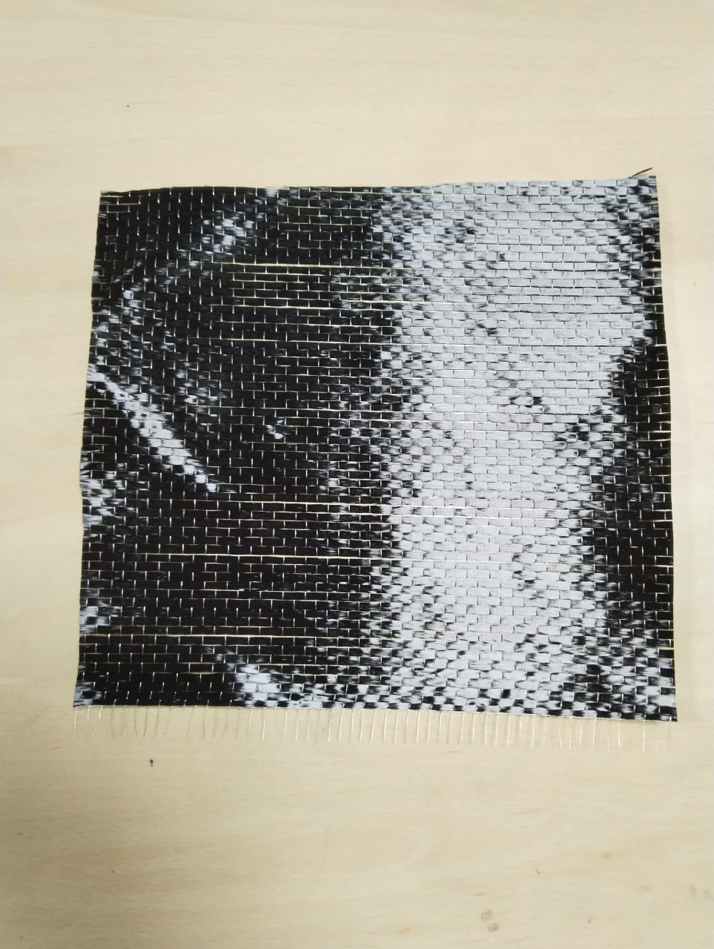
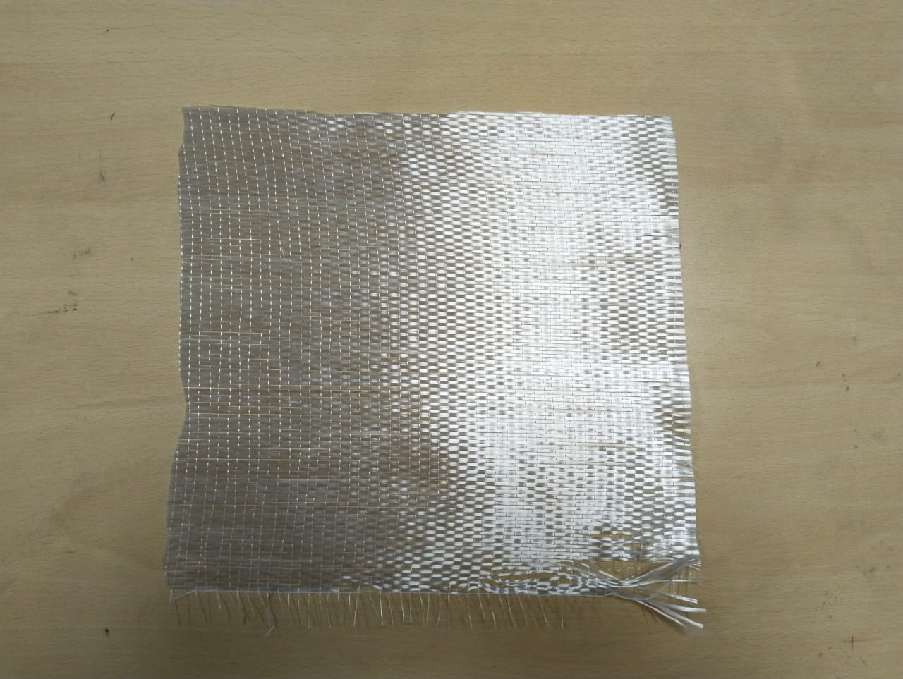
Methodology
Materials used:
Fiber:
Uni-directional carbon fiber Uni-direction Glass fiber

Slide 7
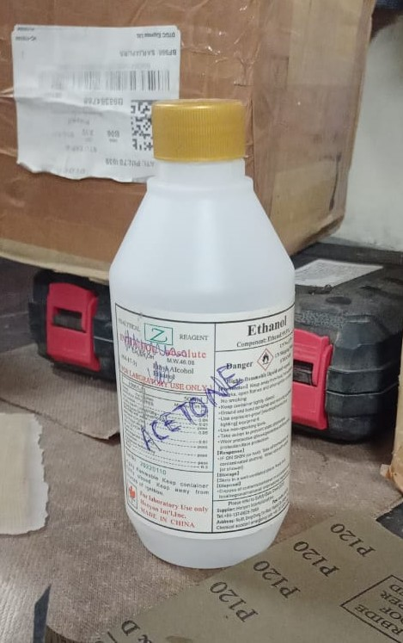
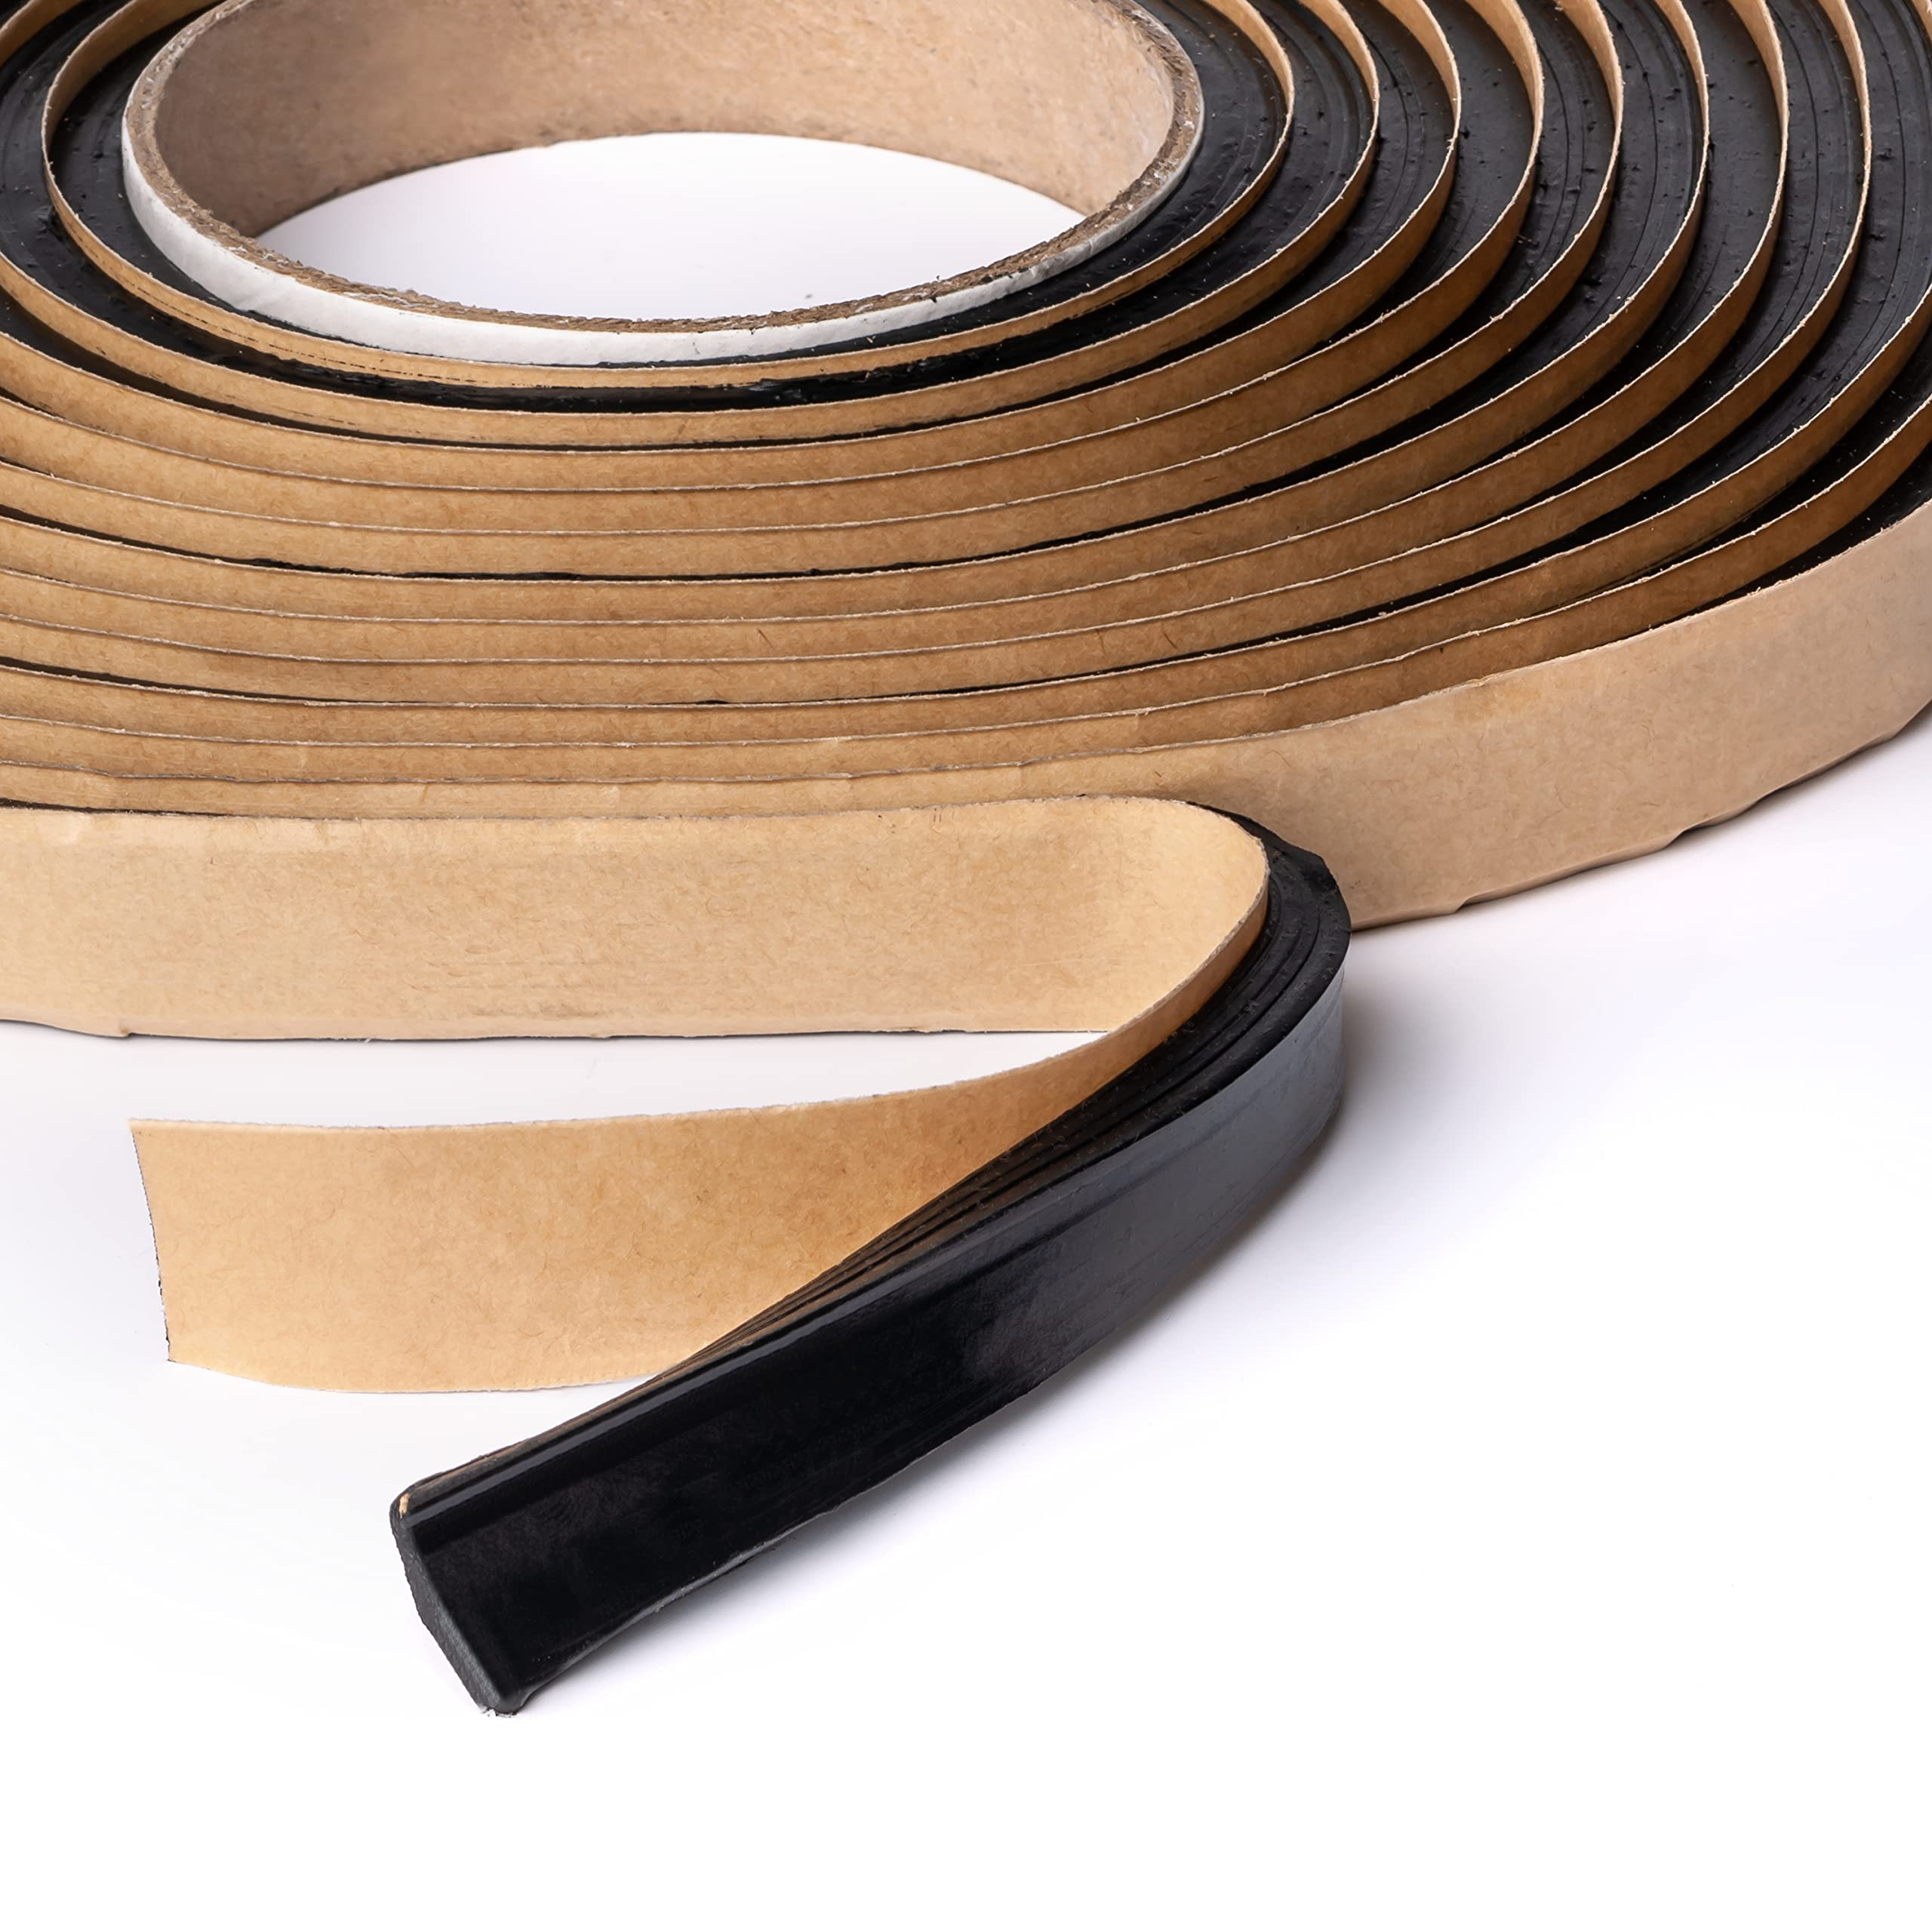
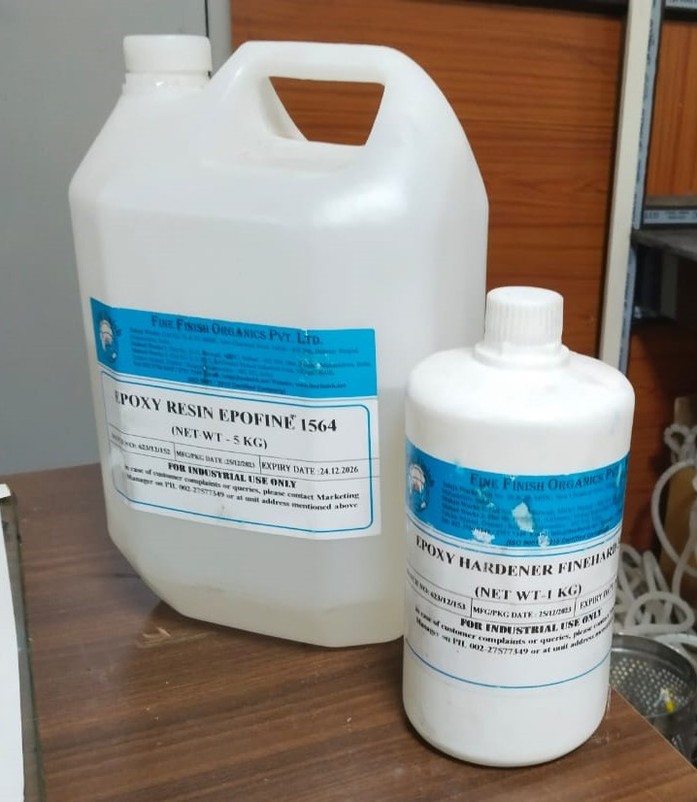
Contd.
Epoxy resin and epoxy hardener
Acetone
Sealant

Slide 8
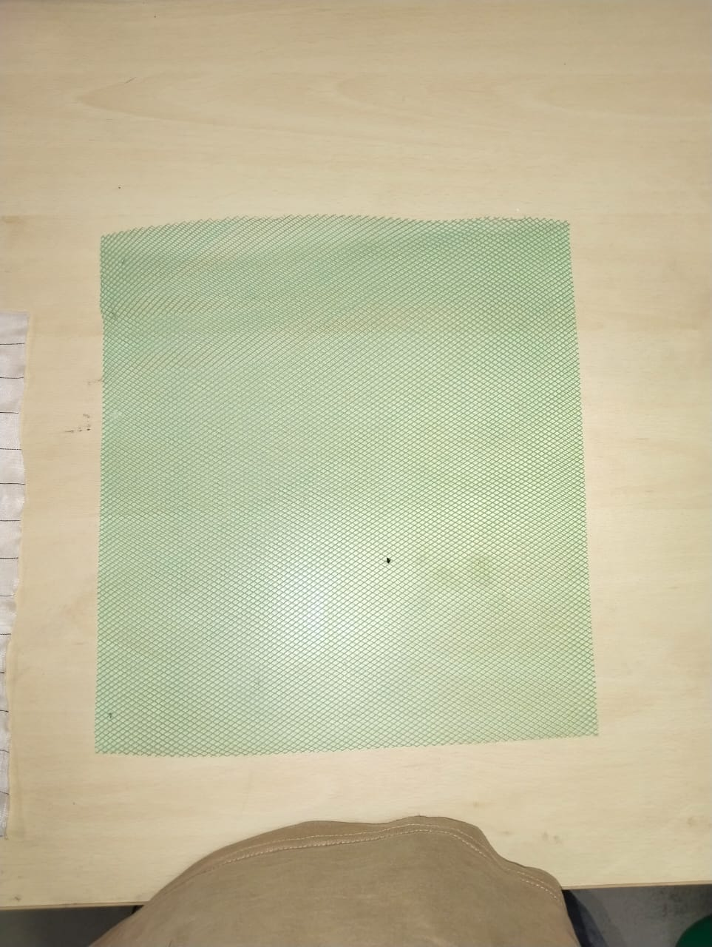
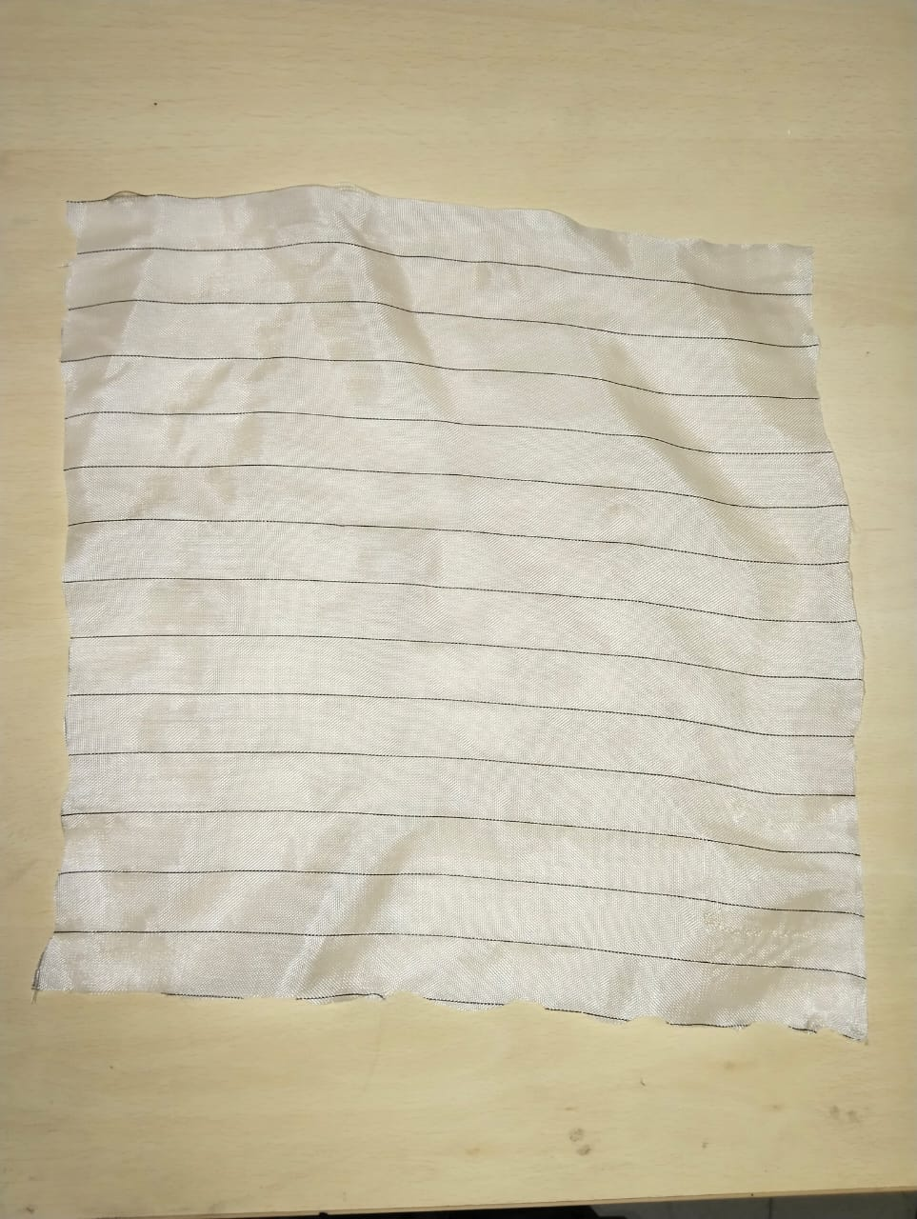
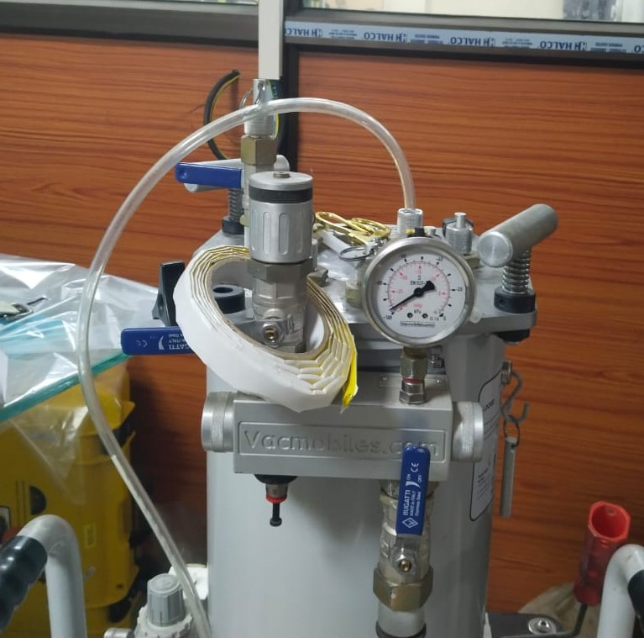
Contd.
Mesh ply
Peel ply
Vacuum pump

Slide 9
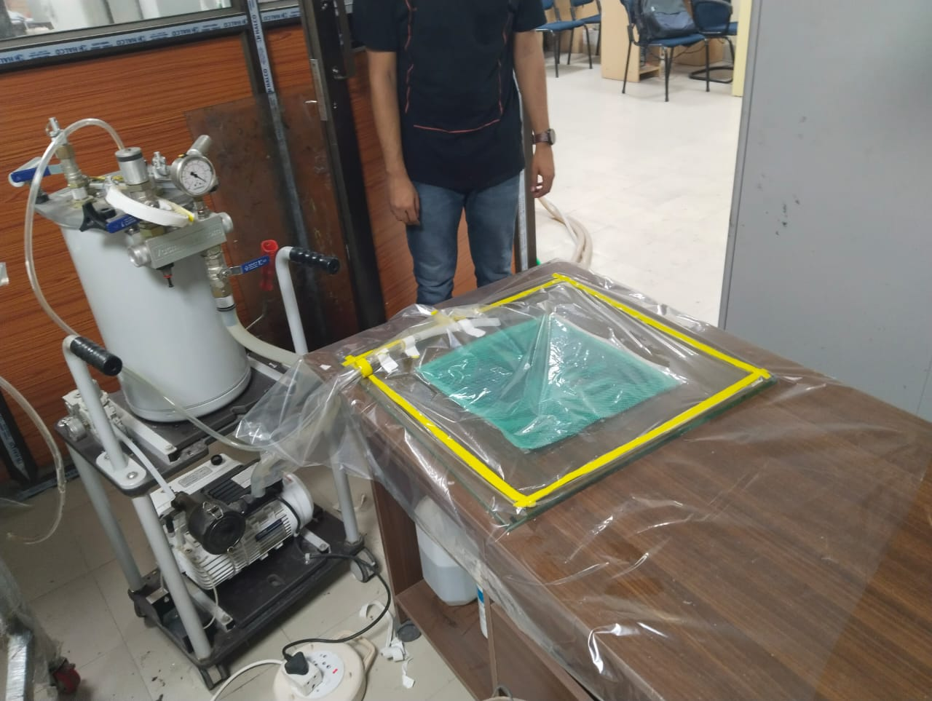
Methodology
Methods used for the manufacturing of composite:
Fiber set up: hand layup of fiber in orientation
Resin infusion: VARTM

Slide 10
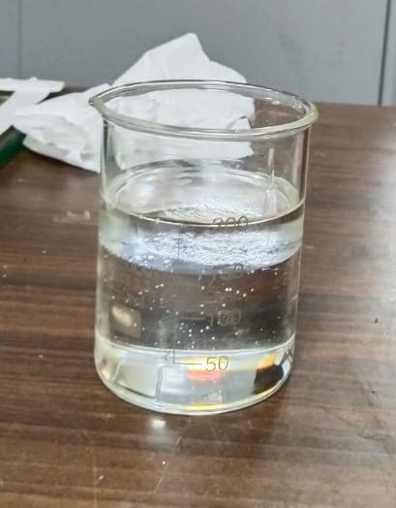
Procedure
Step 1: Cleaning of the working glass base for manufacturing using acetone.
Step 2: Wax was applied on manufacturing surface as a surface treatment and to avoid sticking of the material to the surface.
Step 3: Epoxy resin and the hardener is mixed in beaker at 100:33 ratio i.e, 150ml resin+50ml hardener=200ml.
Fig. Resin + hardener

Slide 11
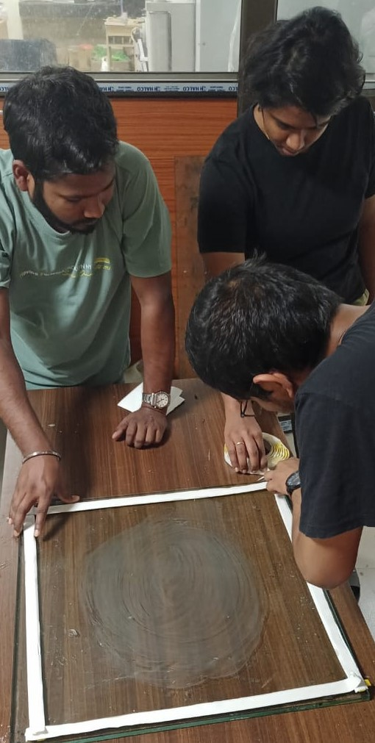
Contd.
Step 4: on the glass base sealant is applied carefully so that there is no air gap.
Fig. Applying sealant
Step 5: Arranging the carbon-glass fiber laminate by orientation respectively and also to apply the epoxy resin layer by layer

Slide 12
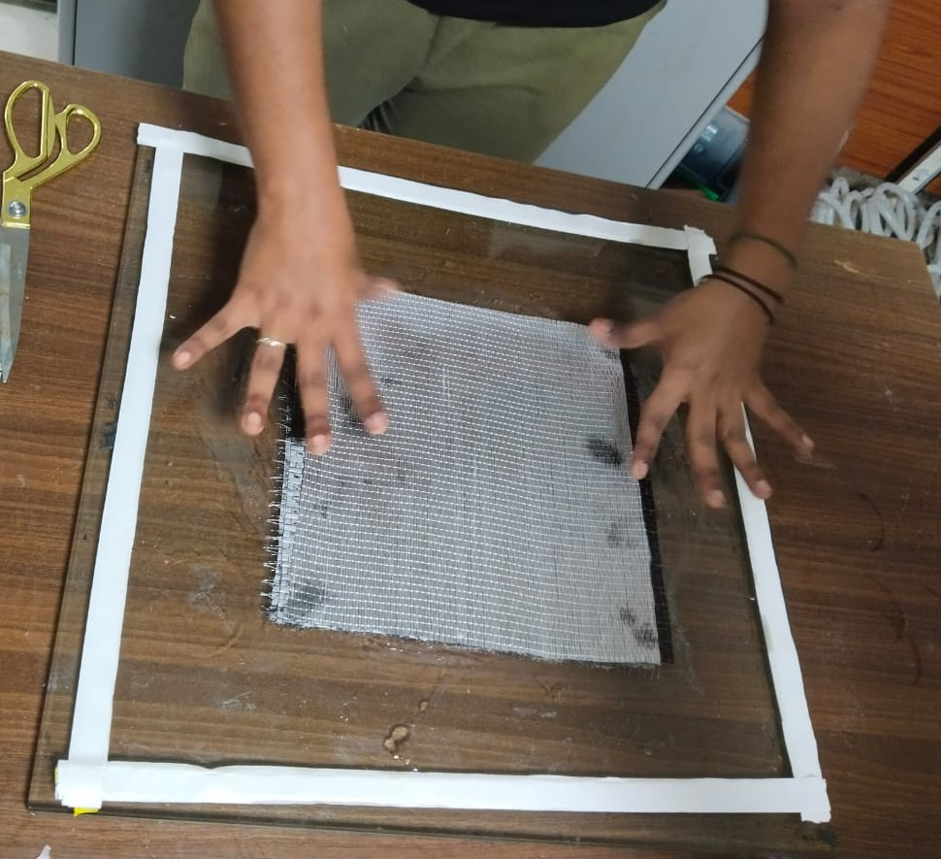
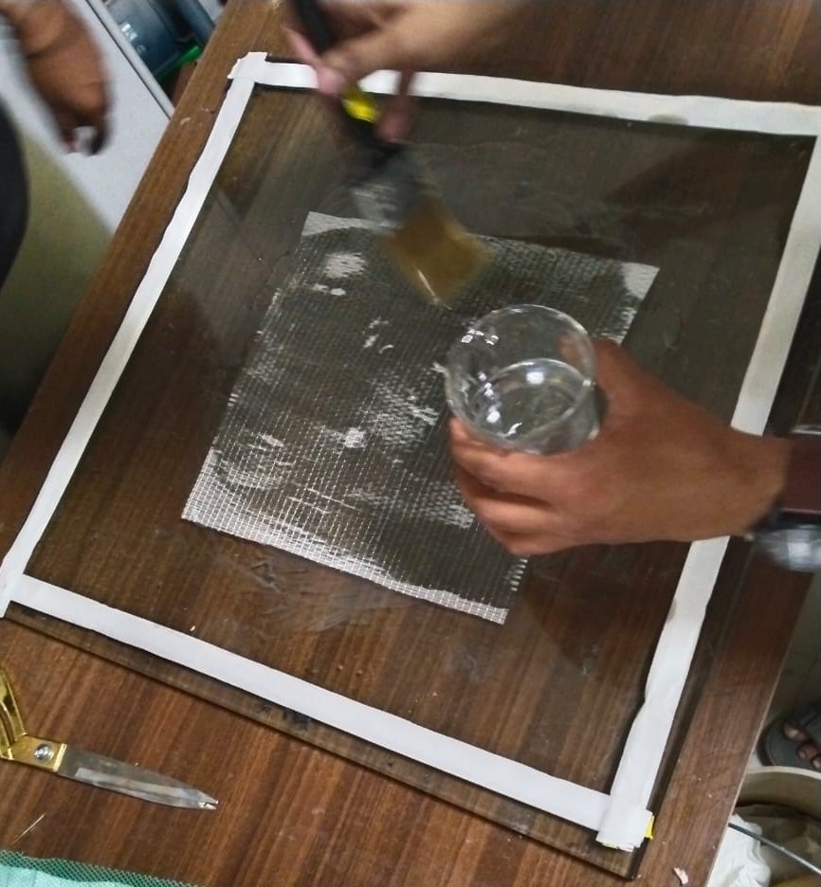
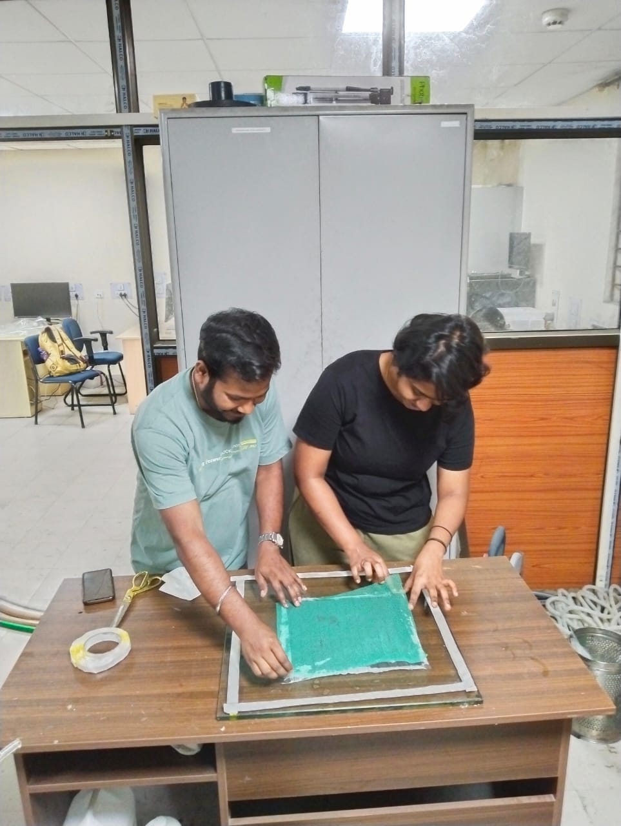
Contd.
by a brush to spread it properly over the fiber.
Fig. Arranging fibers and applying epoxy resin
Step 6: Placing the peel ply and mesh ply over the fibers.

Slide 13
Contd.
Step 7: Apply Vacuum cover spiral pipe(easy air removal)
Attach pipe to vacuum pump and seal the vacuum cover by sealent without any air gap
Step 8: Pump is switched ON. Excess resin is removed.

Slide 14
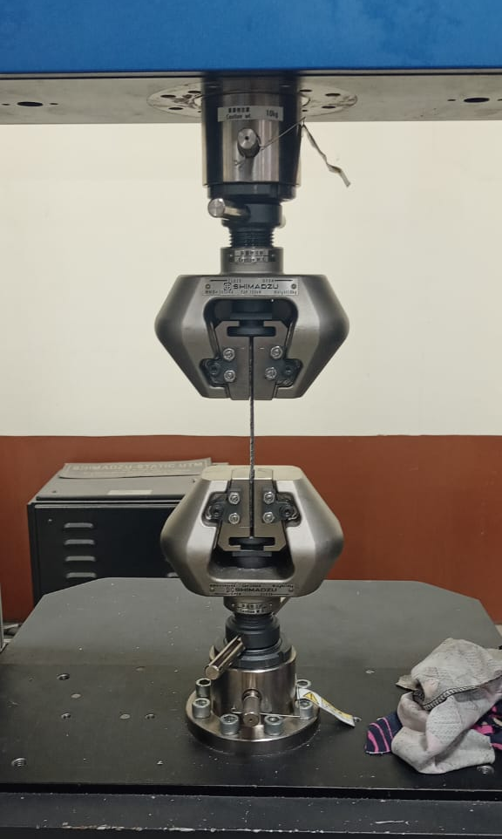
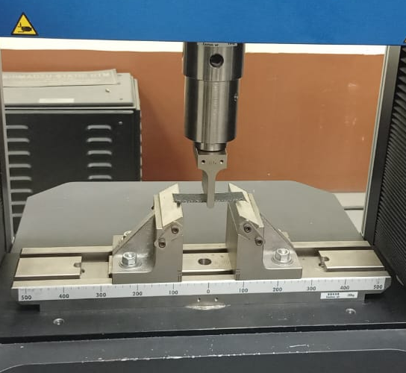
Contd.
Step 9: Curing (24 hrs)
Step 10: Post processing for specimen
Step 11: Tensile and Bending Tests were conducted in the universal testing machine.

Slide 15
Process Parameters
Vacuum pressure
Curing time
Resin permeability
Resin viscosity

Slide 16
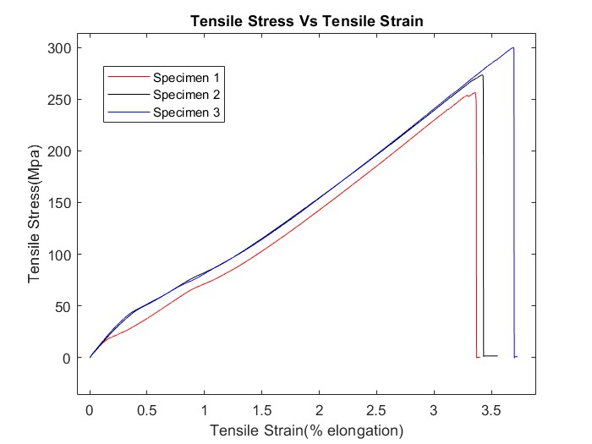
Results
Tensile test result:

Slide 17
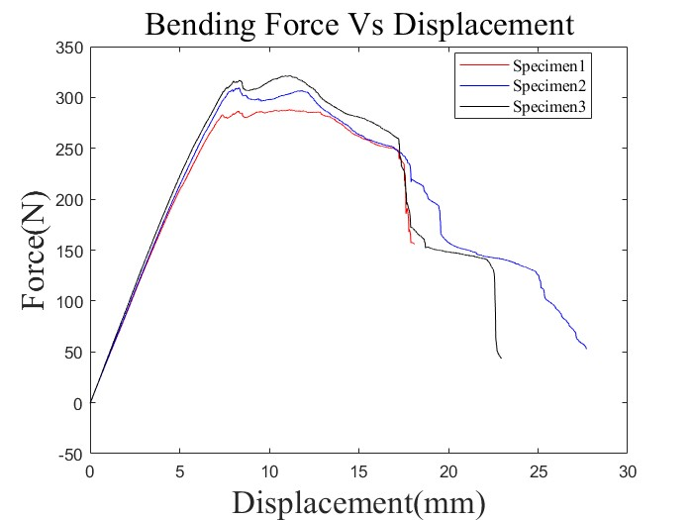
Contd.
Bending test result:

Slide 18
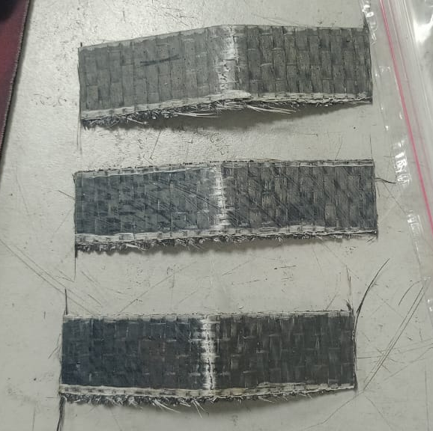
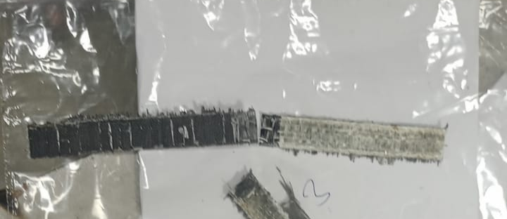
Contd.
Failure nature observed macroscopically

Slide 19
Discussion
The commercially available carbon fiber has a tensile strength of average 3GPa but in the glass fiber laminate enforced specimen has a tensile strength of min 3.5GPa.
With the tailored fiber placement we can improve the material properties of the composite material by placing the fiber where it is needed.
The mechanical properties have been enhanced with the incorporation of glass fiber with carbon fiber.

Slide 20
Conclusions
Observed the process of manufacturing the carbon and glass enforced fiber by VARTM method and its process parameters.
The tensile and bending test was done to understand the mechanical properties of the hybrid material and mostly with the incorporation of glass fiber the ductility is enhanced with some of the other properties.
With the observed results of mechanical properties in the specimen it gives a promising potential for the future advancement in composite material system.

Slide 21
Acknowledgments
Working on the project “Tensile and Bending Testing of Glass/carbon Fiber Polymer Hybrid Composites by VARTM” is a source of immense knowledge. We are highly grateful to Dr. Ujendera Kumar Komal, Assistant Professor, Department of Mechanical Engineering (IITG) for providing this opportunity. The constant guidance and encouragement received from P Rakesh (TA) has been of great help in carrying out the project work and is acknowledged with reverential thanks.
Finally, I am thankful to all whosoever have contributed in this project work.

